Slide 1
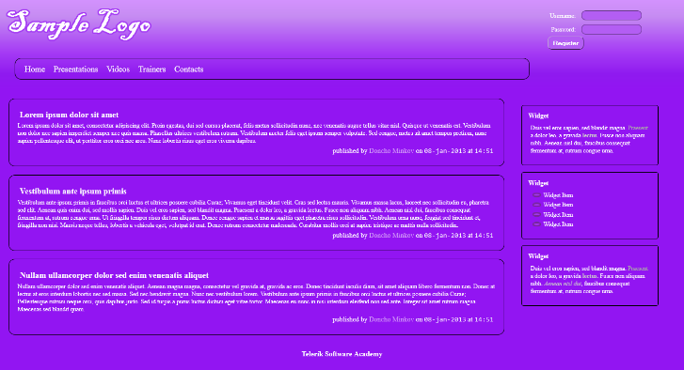
Implement the following using LESS
Use the HTML code from index.html
Create the LESS easy to change (backgrounds, fonts); Use mixins for clears, gradients)

